Slide 1



Electronic Propellant Feed System
Johnny Froehlich, Jonathan Talik, James Luce, Rawand Rasheed, Mimi Shang, Jordan Roland
Affiliations: ¹Portland State Aerospace Society, ²Maseeh College of Engineering and Computer Science Portland, OR, 97201, United States

Slide 2
#5 Final Design and Subsystem breakdown
Delete slide before inserting into active

Slide 3
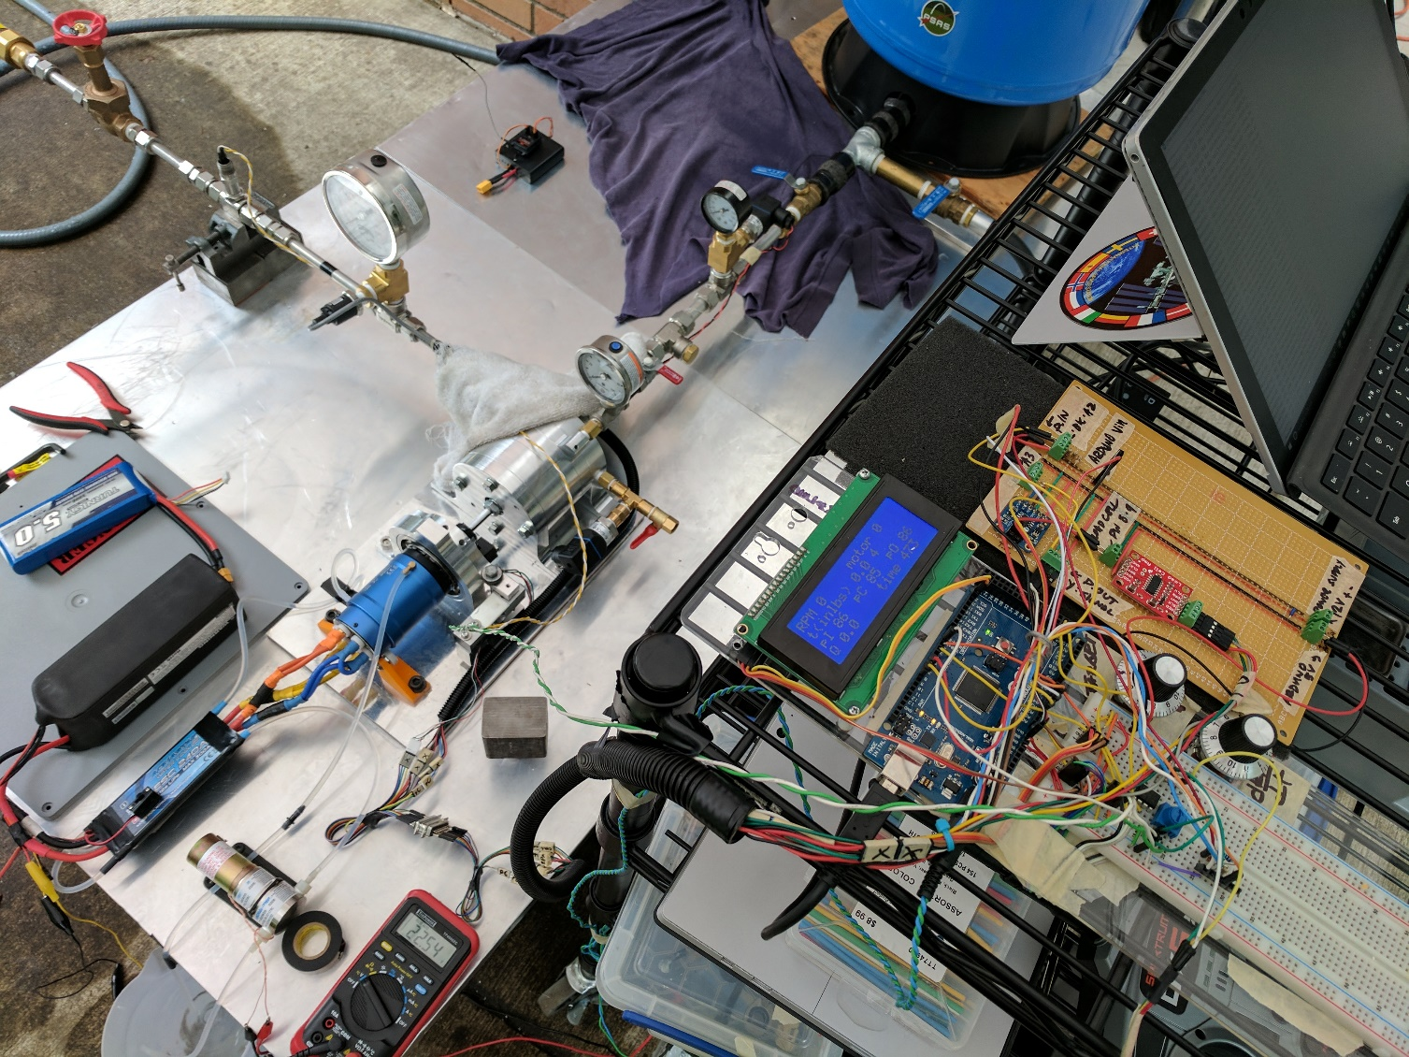
Final Design: Review
To insert:
Flow diagram of testing apparatus – Diagram
Actual Testing Assembly – High res photo
Notes:
look at the thing we created: a testing and development platform for an electric feed system
Portland State Aerospace Society | Electric Propellant Feed System

Slide 4
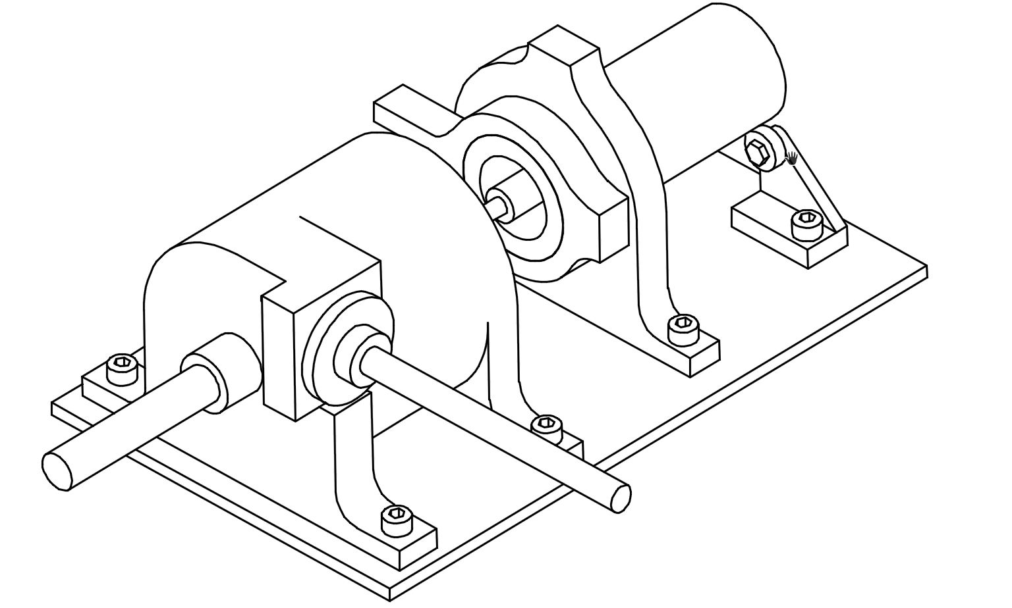
Final Design: Review
To insert:
Flow diagram of testing apparatus – Diagram
Actual Testing Assembly – High res photo
Notes:
look at the thing we created: a testing and development platform for an electric feed system
Portland State Aerospace Society | Electric Propellant Feed System

Slide 5
Electric Feed System
Pump
Testing
Casing
Motor
Apparatus
Measurement
Hydraulic
Dyno Mount
Suction
Pressure
Mechanical
ESC
Air pressure
RPM
Bearings
Batteries
Water
Torque
Seals
Controls
Subsystem Outline

Slide 6
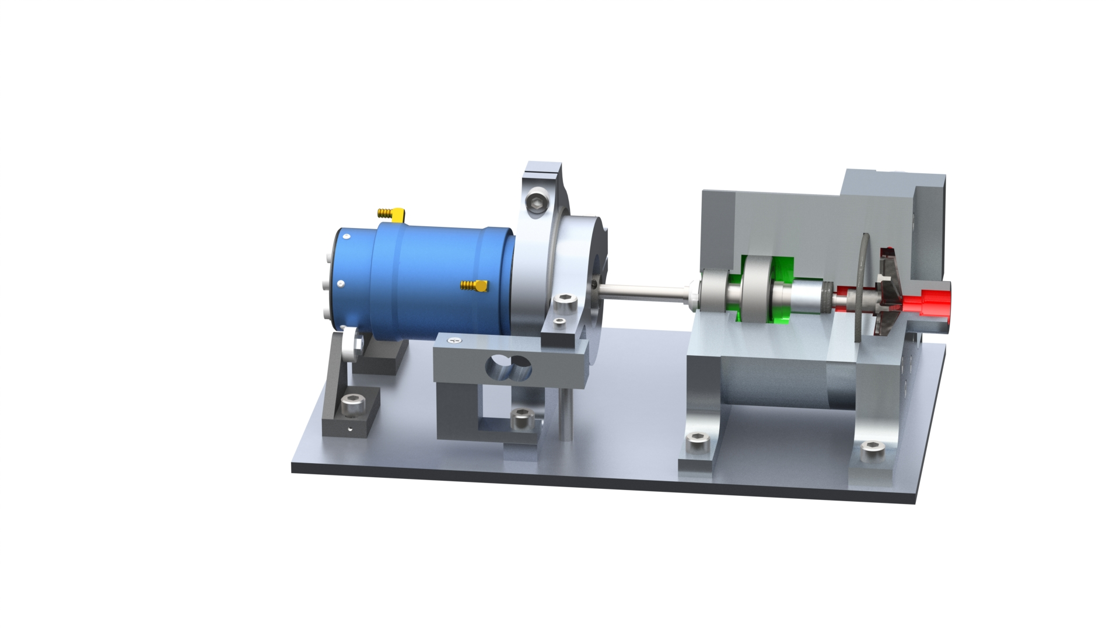
Notes:
Subsystem breakdown:
Pump:
Bearing system
Seal system
Hydraulic system ( volute, impeller, diffuser) – highlight modular design
Shaft
To insert:
Quarter section – CAD
Photo of the pump w/ casing – High Res
Final Design: Subsystem
Portland State Aerospace Society | Electric Propellant Feed System

Slide 7
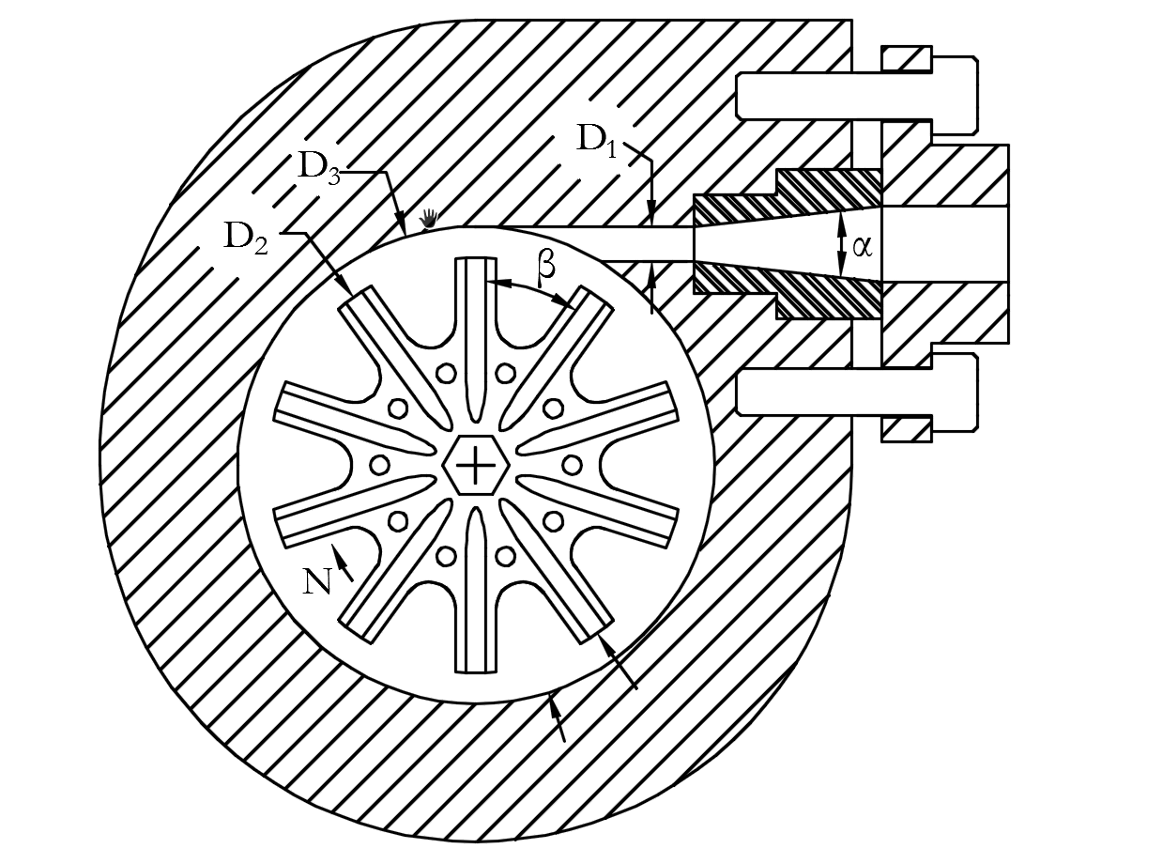
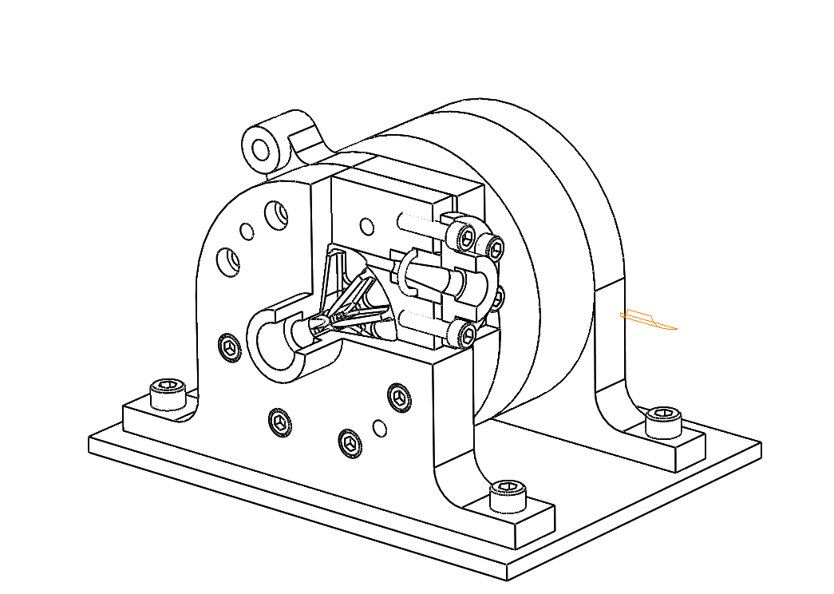
Notes:
Hydraulic design
To insert:
WIT
SECTION VIEW
Final Design: Review
Performance parameters of EFS partial emission pump
Discription |  |  | Value
Q (G.P.M) |  |  | 12
H (ft) |  |  | 754
N_{r} (r/min) |  |  | 20500
P (KW) |  |  | ≤ 3.5
Structure parameters of EFS partial emission pump
Discription |  |  | Value
Impeller Outlet Diameter D₂(in) |  |  | 2.1
Impeller Blade width b₂(in) |  |  | 0.2
Discharge Throat Diameter D₁(in) |  |  | 0.18
Impeller eye Diameter D_{e}(in) |  |  | 0.43
No. of Blades |  |  | 10
Impeller Discharge Angle β(̊) |  |  | 36
Base Diameter of Volute Caseing D₃(in) |  |  | 2.42
Length of Diffuser section L_{D}(in) |  |  | 1.2
Diffusion Angle α(̊) |  |  | 8
Portland State Aerospace Society | Electric Propellant Feed System

Slide 8
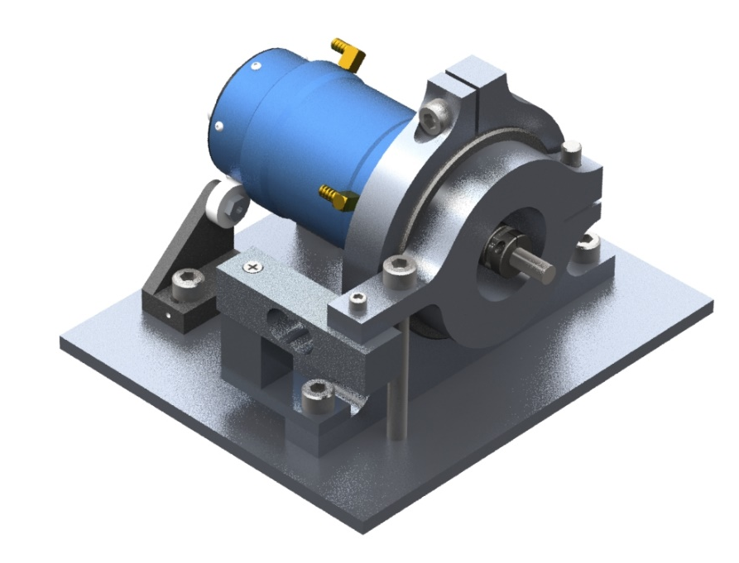
Notes:
Subsystem breakdown:
Drive:
Motor / esc / battery / control
Motor Dyno mount (floating torque measurement)
Motor coupling – Alignment and verifying runout (angular / offset)
To insert:
Rendering of the motor dyno – CAD
Photo or diagram of the motor
Final Design: Subsystem
Motor Dynamometer Mount
Portland State Aerospace Society | Electric Propellant Feed System

Slide 9
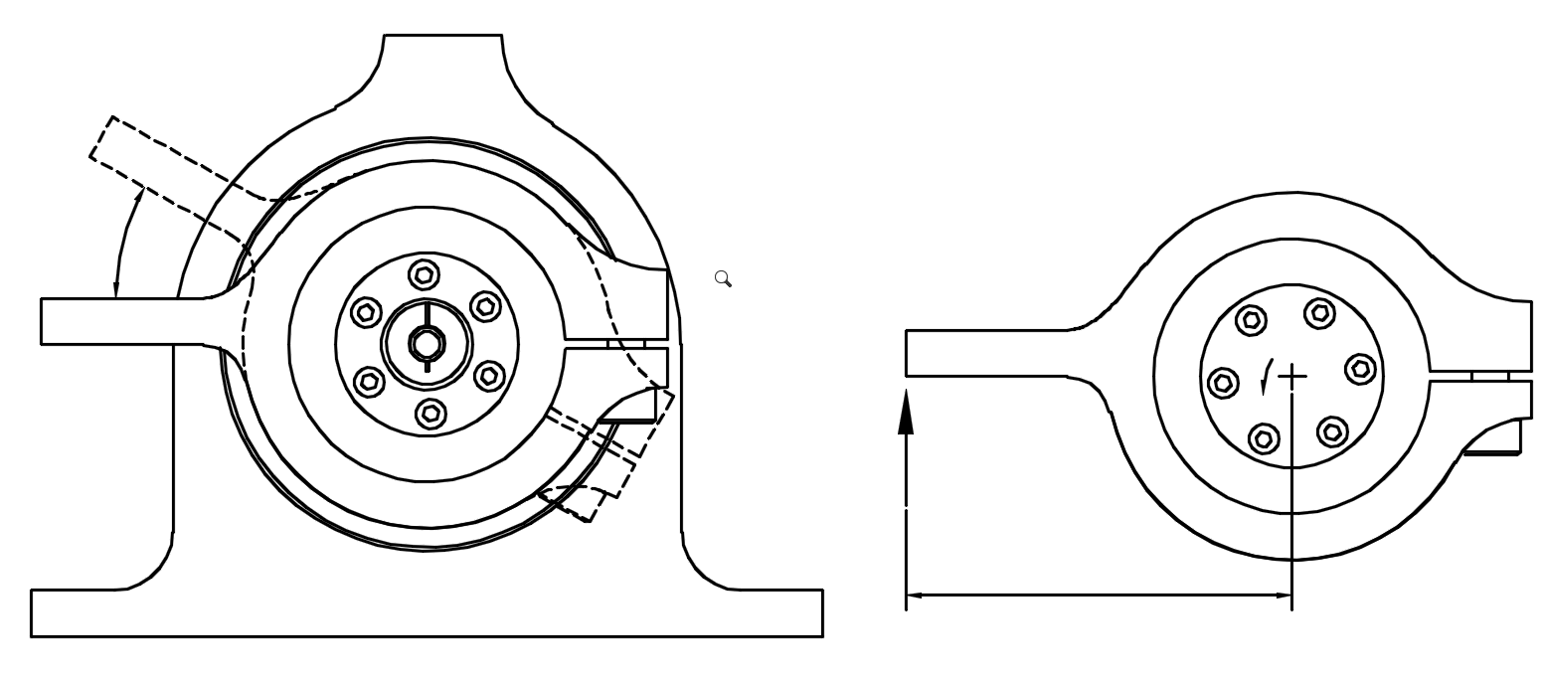
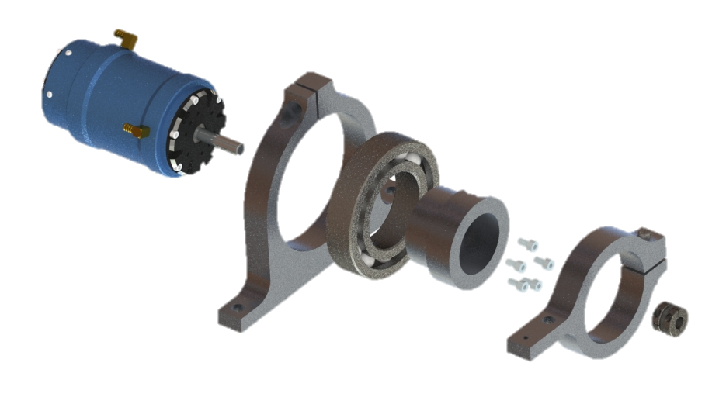
Notes:
Subsystem breakdown:
Drive:
Motor / esc / battery / control
Motor Dyno mount (floating torque measurement)
Motor coupling – Alignment and verifying runout (angular / offset)
To insert:
Rendering of the motor dyno – CAD
Photo or diagram of the motor
Final Design: Subsystem
Motor Mounting and Control
T
R
L
Portland State Aerospace Society | Electric Propellant Feed System

Slide 10
Final Design: Subsystem
To insert:
Flow diagram of testing apparatus – Diagram
Photo of the testing apparatus – high res photo
Photo of DAQ / measurement / harness
Notes:
Subsystem breakdown:
Testing Apparatus:
Tank, suction line, discharge, experimental procedure, cooling
Sensing
Pressure, flow, RPM, Torque
Data Acquisition
Arduino to excel
Portland State Aerospace Society | Electric Propellant Feed System

